Slide 1

Hybrid Digital and Analog Beamforming Design
for Large-Scale Antenna Arrays
Ruoye Wang | 605625594
Yida Chen | 005852117

Slide 2

Outline
Introduction
System model
Main part
RF precoder design
Digital precoder design
Hybrid combiner design
Design extension for
Results and discussion

Slide 3

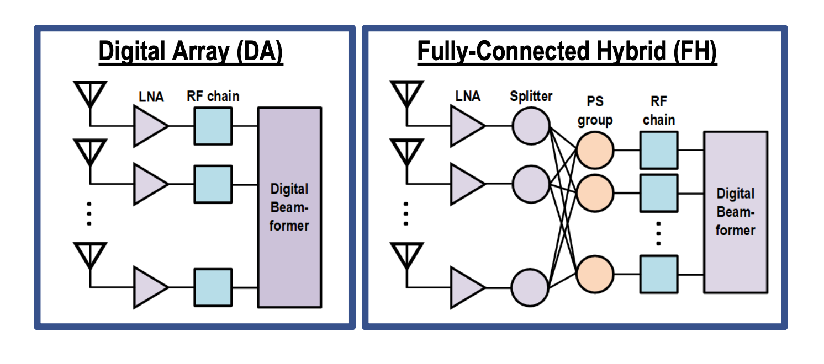
Introduction
Digital beamformer followed by RF beamformer
RF beamformer implemented with analog phase shifters
Two scenarios are considered in this project:

Slide 4
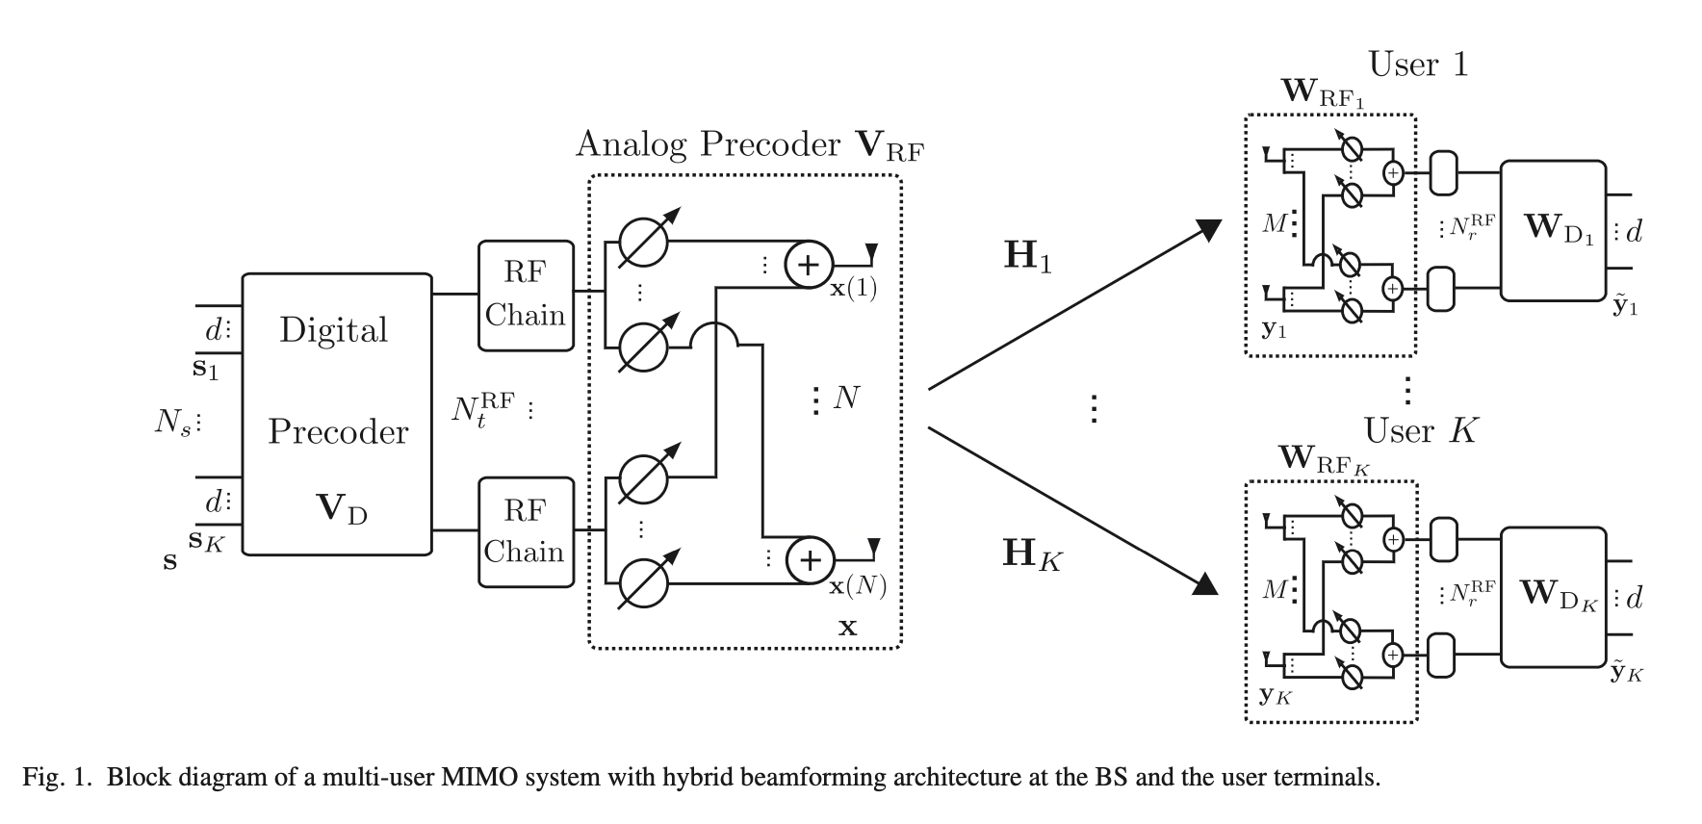
System model

Slide 5
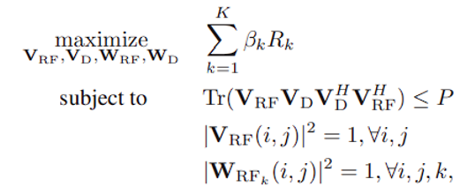
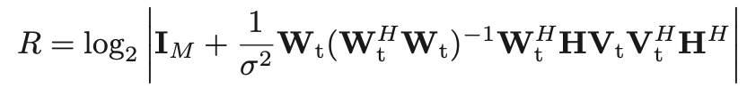
Main part - mathematical objective
Spectral efficiency for user K:
Assuming and K=1 :

Slide 6
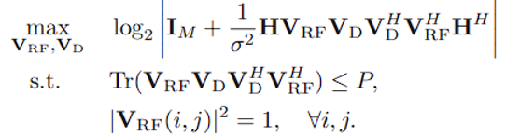
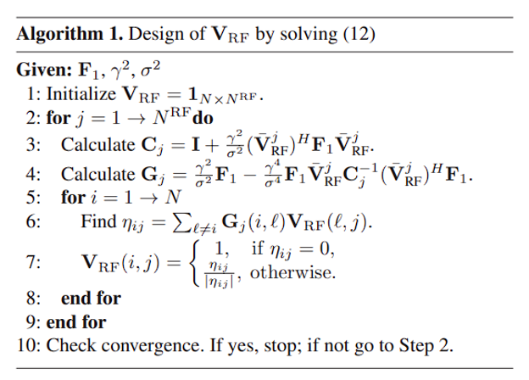

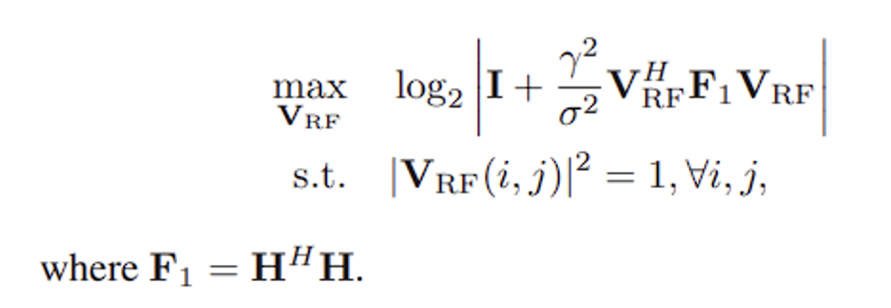
Main part - RF precoder design
Assuming :

Slide 7
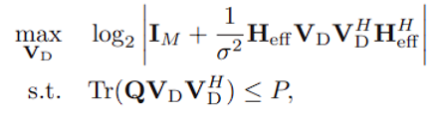
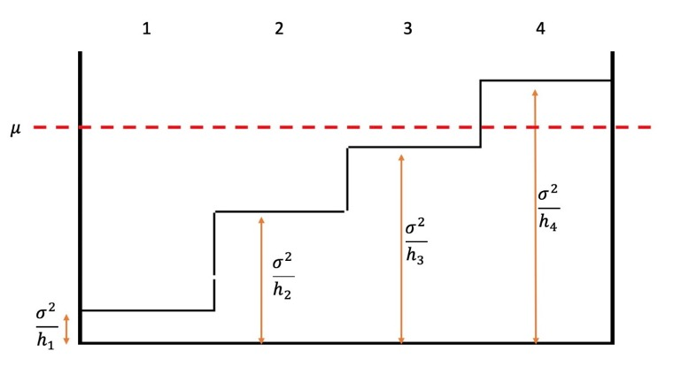
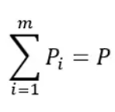
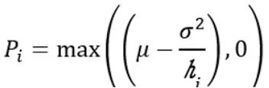
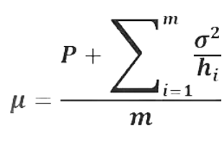

Main part - digital precoder design
Using a water filling solution:
The matrix of digital precoder can be calculated by:

Slide 8
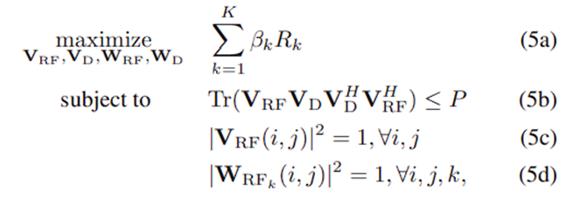
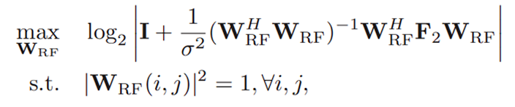

Main part - RF combiner design
Precoders designed

Slide 9
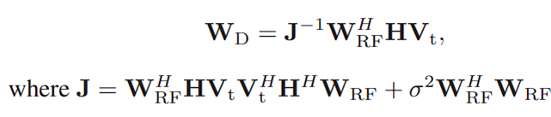
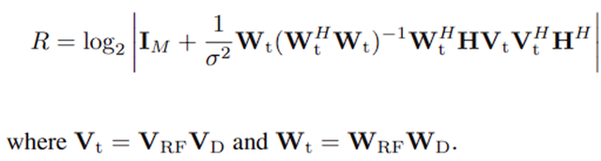

Main part - digital combiner design
MMSE solution
Precoders √
Combiners √
Performance metrics:
Spectral efficiency
Design process repeated for

Slide 10
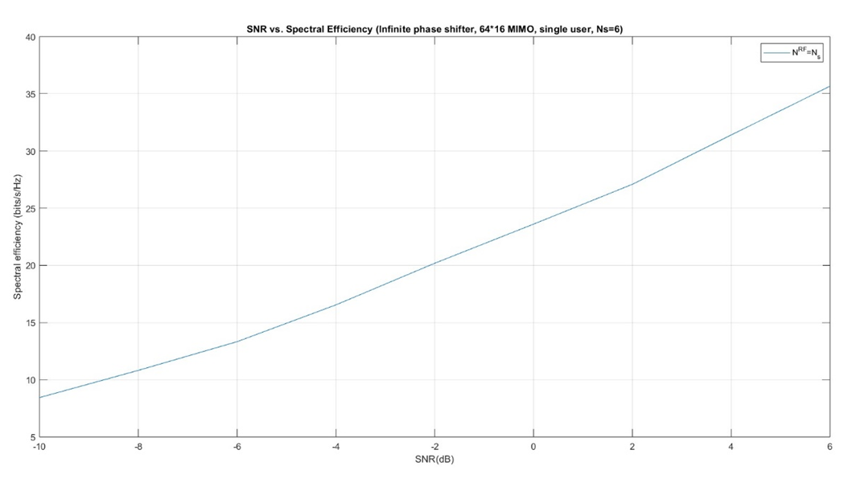
Result 1 - 64*16 MIMO, NS=NRF=6

Slide 11
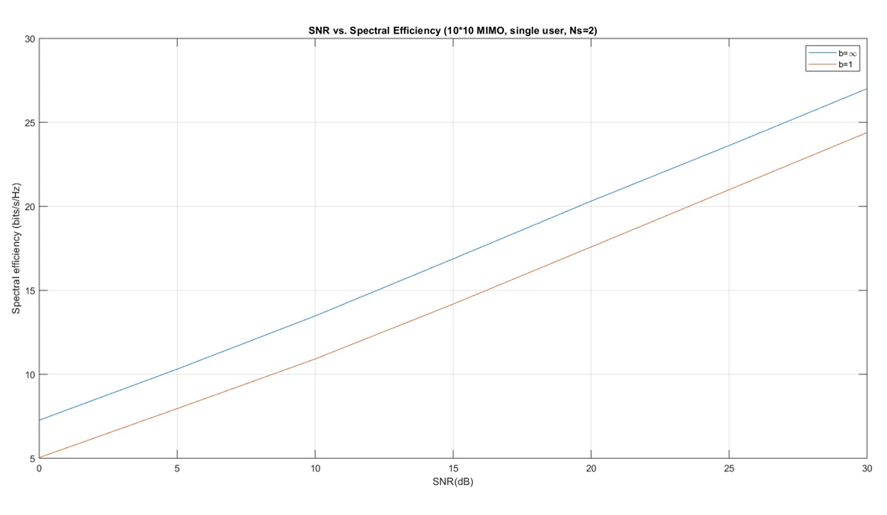
Result 2 - 10*10 MIMO, NS=NRF=2
Infinite resolution phase shifter has better performance.
Possible reason: no quantization

Slide 12
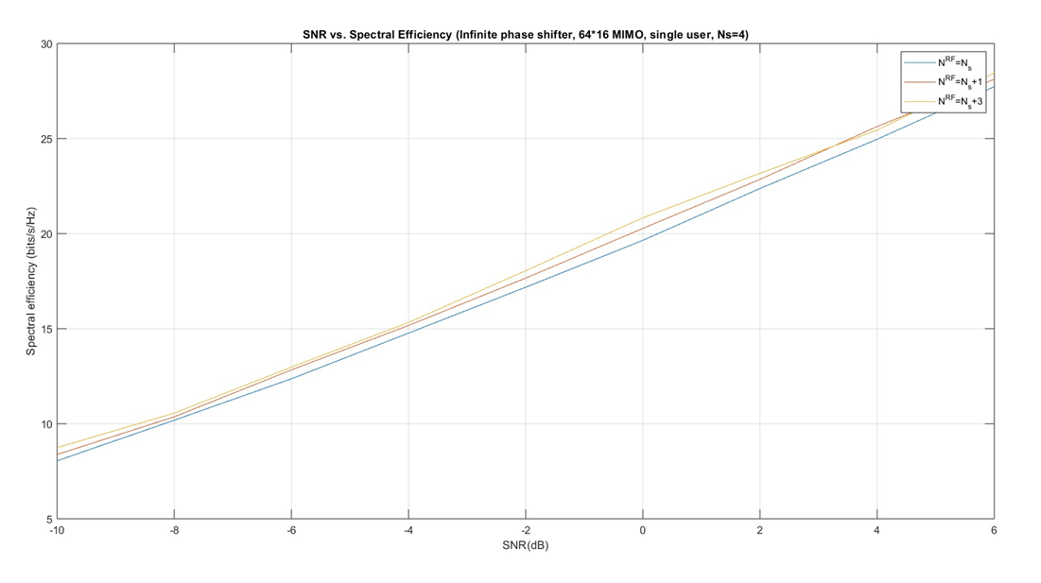
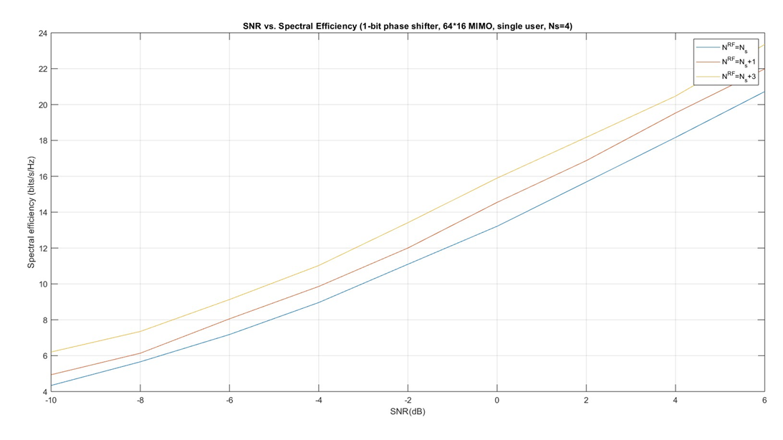
Result 3 - 64*16 MIMO, NS=4, NRF={NS, NS+1, NS+3}
100 Monte Carlo trials
Spectral efficiency increases as the number of RF chains increase
1-bit phase shifter with more RF chains has a performance close to infinite phase shifters

Slide 13
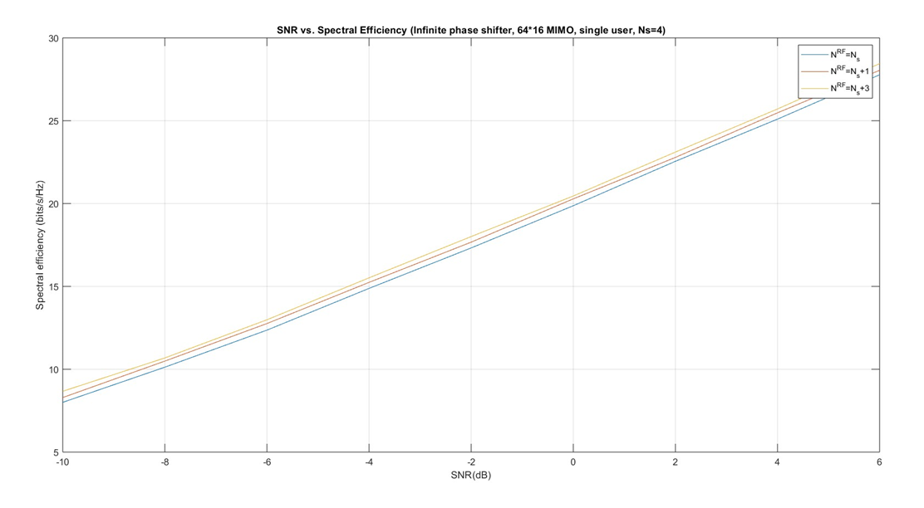
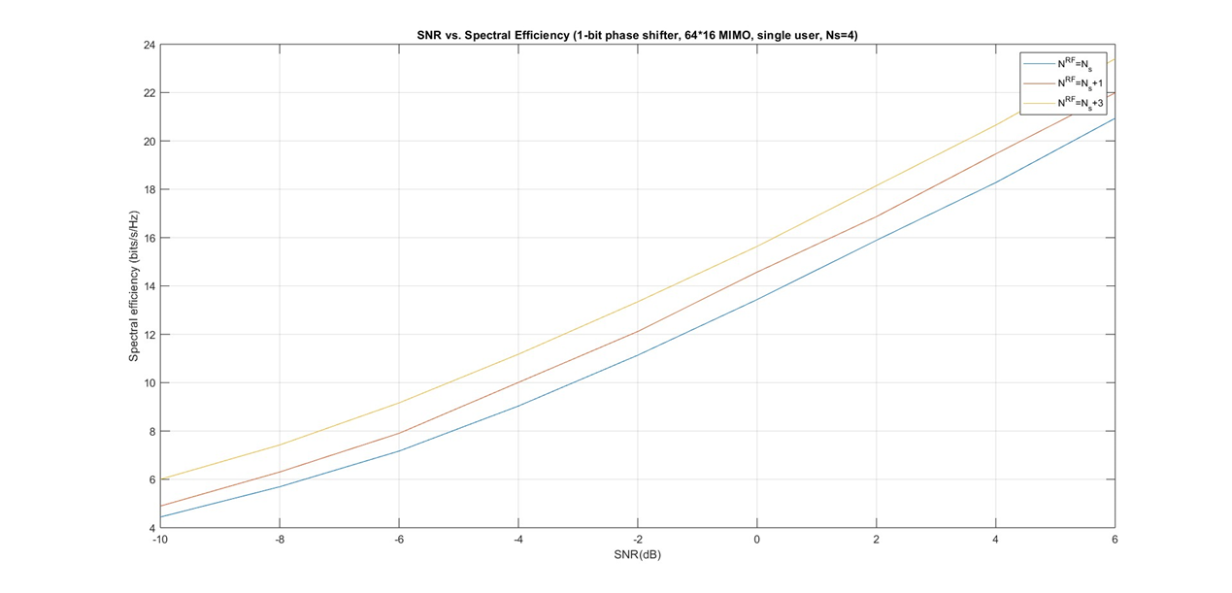
Result 3 - 64*16 MIMO, NS=4, NRF={NS, NS+1, NS+3}
1000 Monte Carlo trials
The increased number of RF chains can be used to trade off the accuracy of phase shifters in hybrid beamforming design.

Slide 14
Conclusion
Beamformer design
Precoders
Combiners
Number of data streams vs. number of RF chains
NS = NRF
NS < NRF = {NS, NS+1, NS+3} < 2NS
Spectral efficiency
Increasing the number of RF chains can trade off the inaccuracy of phase shifters in hybrid beamformer architectures to achieve a closer performance to that of fully digital beamformer architectures.

Slide 15
Thank you
GitHub: https://github.com/Ruoye36/ECE233_Project_1

